Slide 1
Driving Customer Loyalty: Uncovering Churn Drivers in Telecom
Insights from Telcecom Customer Churn Analysis

Slide 2
The Churn Challenge
High customer churn threatens telecom revenue and lifetime value—costs millions in acquisition.
Key Question: Why are customers leaving, and how prevalent is it?
Objective: Analyze Telecom dataset to quantify churn (26.5%) and identify drivers (e.g., contract, tenure) for retention strategies.
"Churn is the silent killer of telecom profits." – Industry Report

Slide 3

Our Analytical Approach
Data Prep: Cleaned 7043 records (filled TotalCharges missing values).
EDA: Explored churn patterns via visualizations (Python: pandas, seaborn).
Insights: Bivariate analysis of key factors (tenure, charges, services).
Recommendations: Actionable strategies to reduce churn by 10-15%.
Tools: Python, Matplotlib/Seaborn.

Slide 4
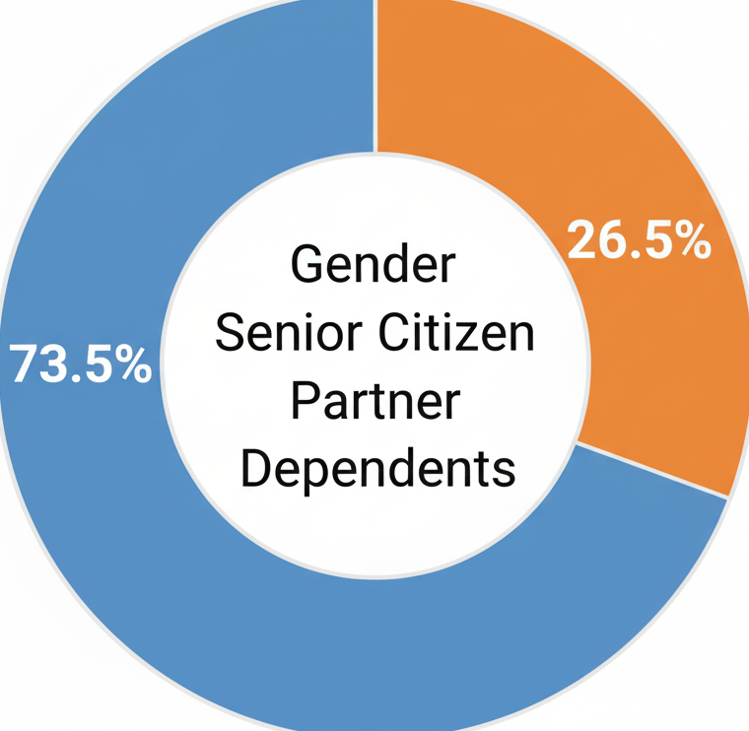


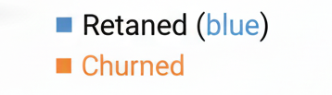
Dataset at a Glance
Customers:
7,043
Churn Rate:
26.5%
Avg. Tenure:
32 Months
Avg. Monthly Charge:
$64.76
Services
Phone Service
Online Security
Internet Service
Streaming TV
Billing
Paperless Billing
Payment Method
Monthly Charges
Total Charges
21 columns; Cleaned (no nulls post-TotalCharges fix); Focus: Demographics, Services, Billing.

Slide 5
Project Workflow
Data Load & Clean → Handle TotalCharges (fillna=0); Drop customerID.
EDA Setup → Calculate churn rate; Bin tenure/charges.
Visual Analysis → Bivariate plots (histograms, pies, scatters).
Insight Extraction → Identify drivers (e.g., month-to-month = 42.7% churn).
Recommendations → Target high-risk segments.
Start
End

Slide 6
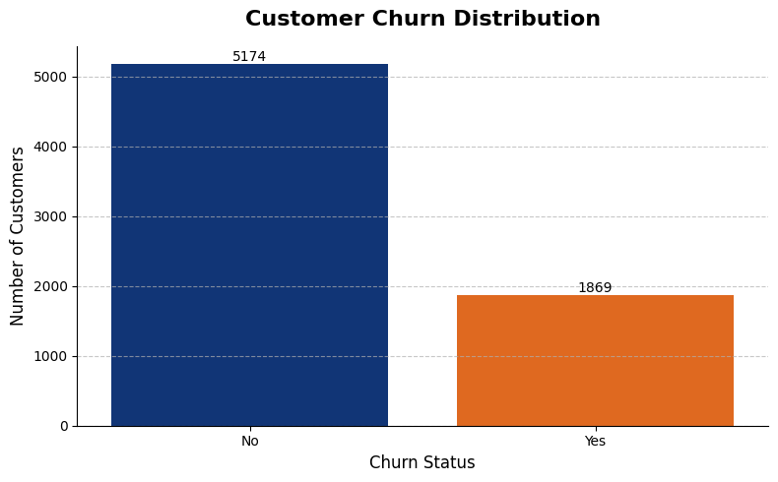
Baseline: Overall Churn Rate
Insight: 26.5% of customers churn, equating to ~1,869 lost annually—highlighting urgent retention needs.

Slide 7
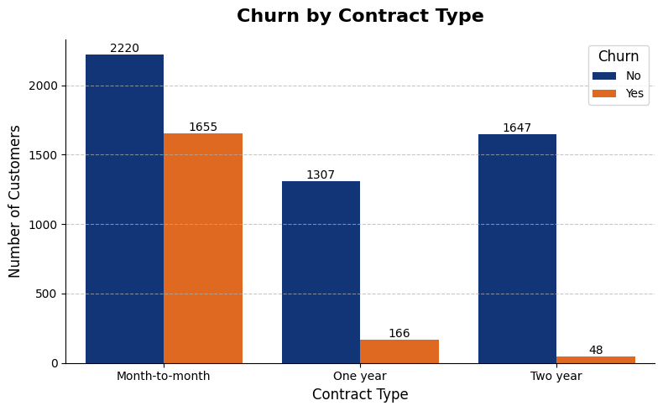
Driver 1: Contract Length Impacts Loyalty
Insight: Month-to-month contracts see 42.7% churn vs. 2.9% for two-year—longer commitments reduce attrition by 94%.

Slide 8
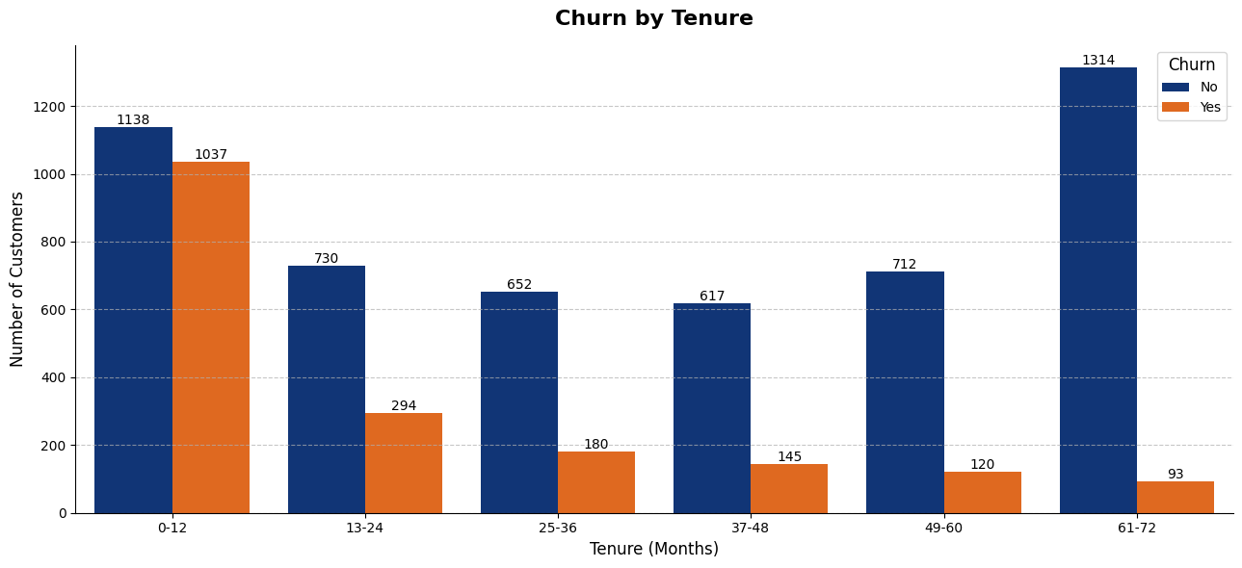
Driver 2: New Customers at Highest Risk
Insight: Customers with <12 months tenure churn at 47.7%—early onboarding interventions could save 40% of at-risk users.

Slide 9
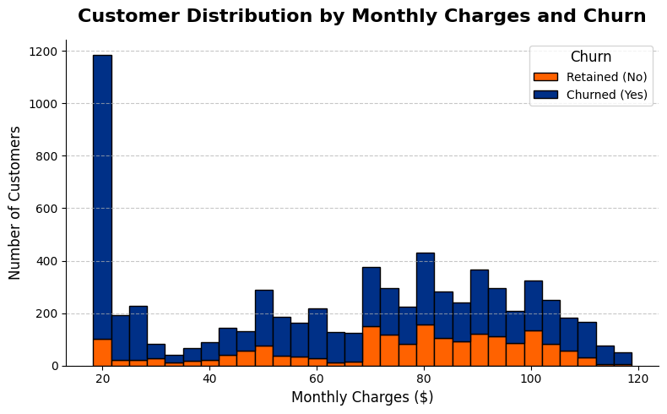
Driver 3: Pricing Sensitivity Drives Exit
Insight: Charges >$80/month correlate with 34% churn—premium plans need value justification to retain 20% more customers.

Slide 10
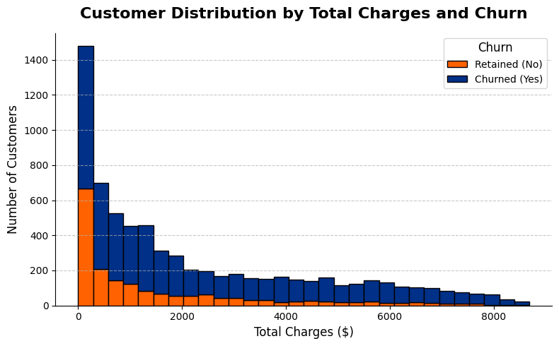
Cumulative Impact: Total Spend vs. Retention
Insight: Low total charges (<$1K) show 37% churn, confirming new/low-tenure customers as prime targets for loyalty programs.

Slide 11
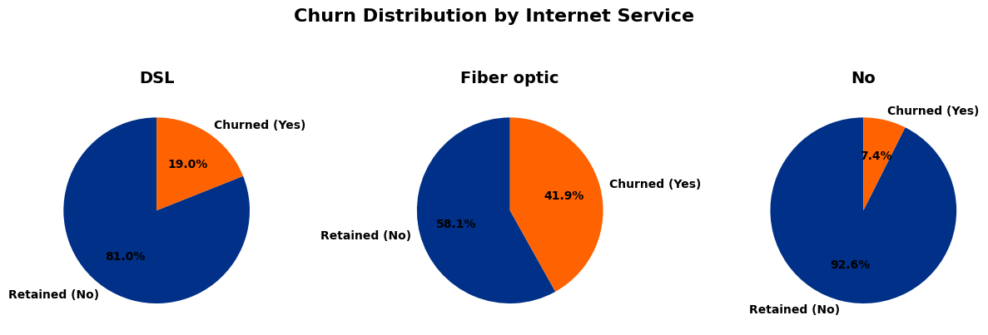
Service-Specific Vulnerabilities
Insight – Fiber optic: 41.9% churn—speed vs. reliability gap?
Insight – DSL: 19.0%—stable but upgrade opportunities.
Insight – No service: 7.4%—bundling could boost uptake.

Slide 12
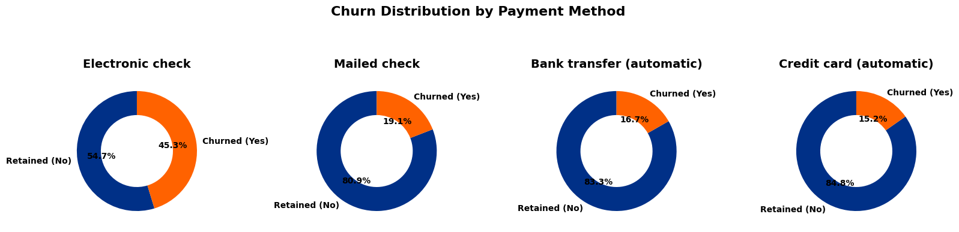
Friction in Payments Fuels Churn
Insight – Electronic check: 45.3%—manual process dissatisfaction.
Insight – Mailed check: 19.1%—legacy friction
Insight – Auto payments: ~16%—seamless options retain better.

Slide 13
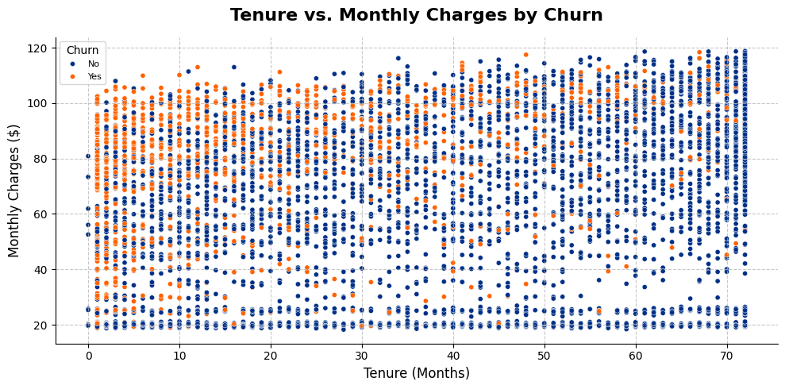
Interaction: Low Tenure + High Charges = High Risk
Insight: Clusters of low-tenure/high-charge churners (orange points)—targeted discounts could cut this segment's 50%+ attrition.

Slide 14
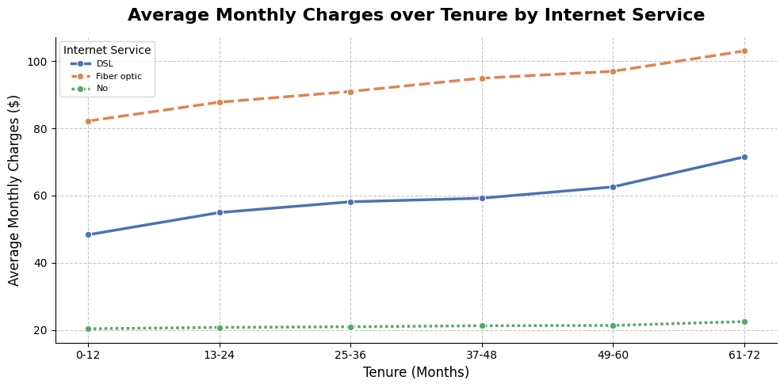
Service Type Amplifies Charge Sensitivity Over Time
Insight: Fiber optic lines rise steeply in early tenure, driving 42% churn—service bundling in year 1 could stabilize 25% more revenue.

Slide 15

Actionable Recommendations
Immediate (High Impact)
Promote 1-2 year contracts with 20% onboarding discounts—potential 30% churn reduction.
Short Term
Enhance Fiber optic support (e.g., dedicated tech line)—target 41.9% service churn.
Long Term
Shift to auto-payments via incentives—lower 45% electronic check attrition.
Implement top 3 in Q4; Projected ROI: +15% retention, $.82MM revenue lift in the first year.

